Slide 1
Seeding Rate Effects on Ethanol Production in Corn and Sorghum
Todd Ballard IGERT fellow Kansas State University Department of Agronomy
Sunil Bansal GRA K-State Department of Grain Science and Industry
Shirley Agrupis Borlaug fellow Mariano Marcos State University
Lucas Haag Assistant Scientist K-State Research and Extension
Praveen Vadlani Assistant Professor K-State Department of Grain Science and Industry
Scott Staggenborg Professor K-State Department of Agronomy
International Symposium on Renewable Feedstock for Biofuel and Bio-based Products 11/8 – 13/8 2010

Slide 2
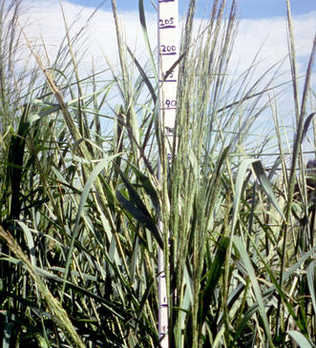

Biomass and Bioethanol
Biomass is any organic matter, Including trees, plants, plant fiber, and animal wastes.
Renewable energy source
Ethanol produced by hydrolysis of biomass to sugars and their fermentation is called as bioethanol
Benefits include decoupling of food and bioenergy, reduce CO₂ emissions and ensurance of stable supply of energy (Larsen et al., 2008)

Slide 3
Process Flowchart for Ethanol from Biomass
Biomass feedstock
Enzymatic hydrolysis
Pretreatment
Fermentation
Ethanol
Lignin
Lignin and residue
Chemicals, feed or combustion for generation of energy

Slide 4
Goals
To produce ethanol from corn (Zea mays L.) stover and sweet sorghum (Sorghum bicolor L. cultivar “sweet) begasse
To find a relationship between plant population densities and ethanol yield/ha
To minimize the impact of ethanol production of food supply from both crops

Slide 5
Background Population Relationships Used
Duncan grain yield model (Duncan, W.G. 1958)
Shinozaki and Kira biomass model (Shinozaki, K. and T. Kira 1956)
Russell biomass model (Russell, M.W. 1979 and Ballard 2008)

Slide 6
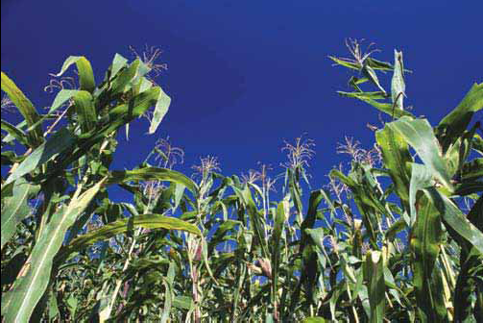

Slide 7
Locations
Manhattan, KS
  39.19 ⁰ N
  89 cm rain/yr
^{Tribune, KS}
  38.28 ⁰ N
  44 cm rain/yr
Garden City, KS
  37.99 ⁰ N
  48 cm rain/yr

Slide 8
Seeding Rates for Corn
Manhattan
  No competition: 2,900/ha
  37,000/ha
  64,000/ha
  103,000/ha
  140,000/ha
Tribune
  No competition
  29,600/ha
  44,500
  59,200

Slide 9
Corn Grain Yield

Slide 10
Total Corn Biomass

Slide 11
Corn Stover Yield

Slide 12
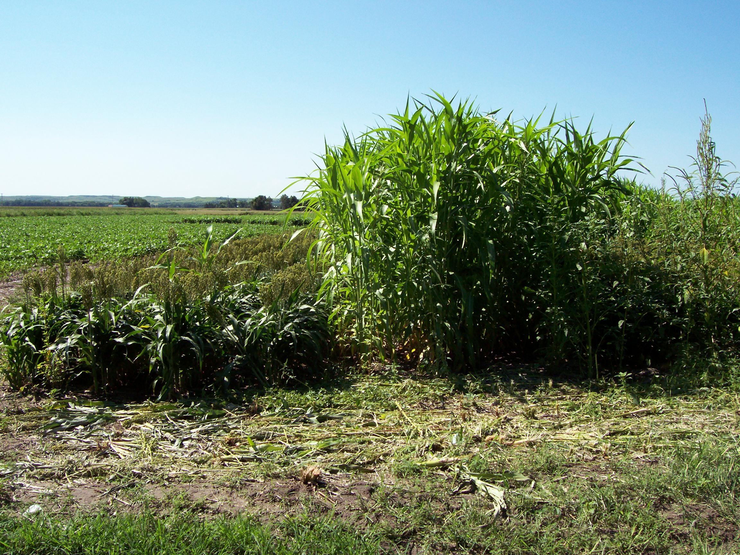

Slide 13
Seeding Rates for Sorghum
Manhattan
  74,000/ha
  148,000/ha
  222,000/ha
Garden City
  37,000/ha
  74,000/ha
  111,000/ha

Slide 14
Begasse Yield

Slide 15
Ethanol Process
Acid hydrolysis
  2% H₂SO₄
  121⁰ C for 30 minutes
Wash to remove acid
Add pH 5.0 citric acid as a pH buffer
Add cellulase (22074) and glucosidase (50010) from Novozyme
  72 hr enzyme hydrolysis
Fermentation
  Yeast extract
  Ammonium Sulfate
  Yeast
  15 hr

Slide 16
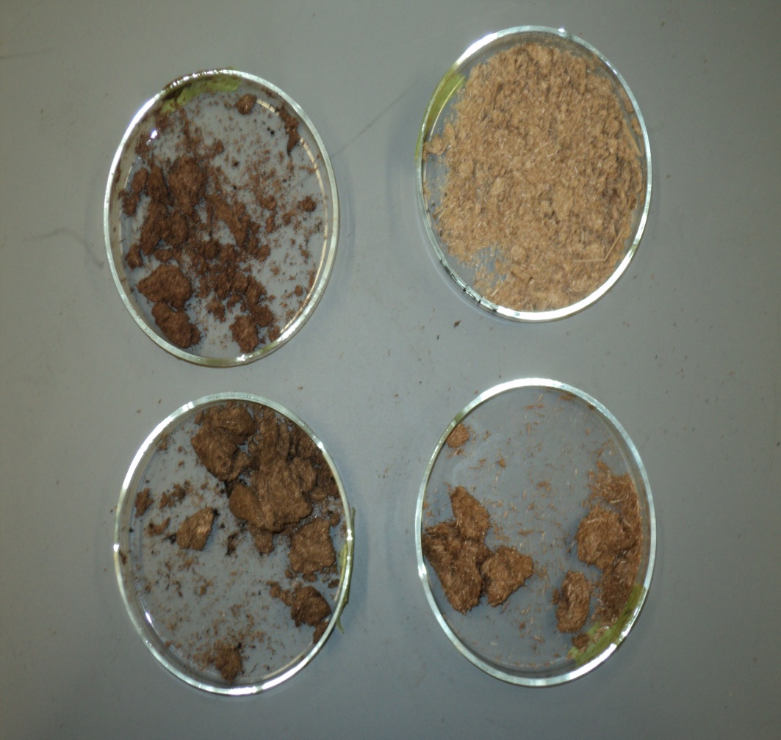
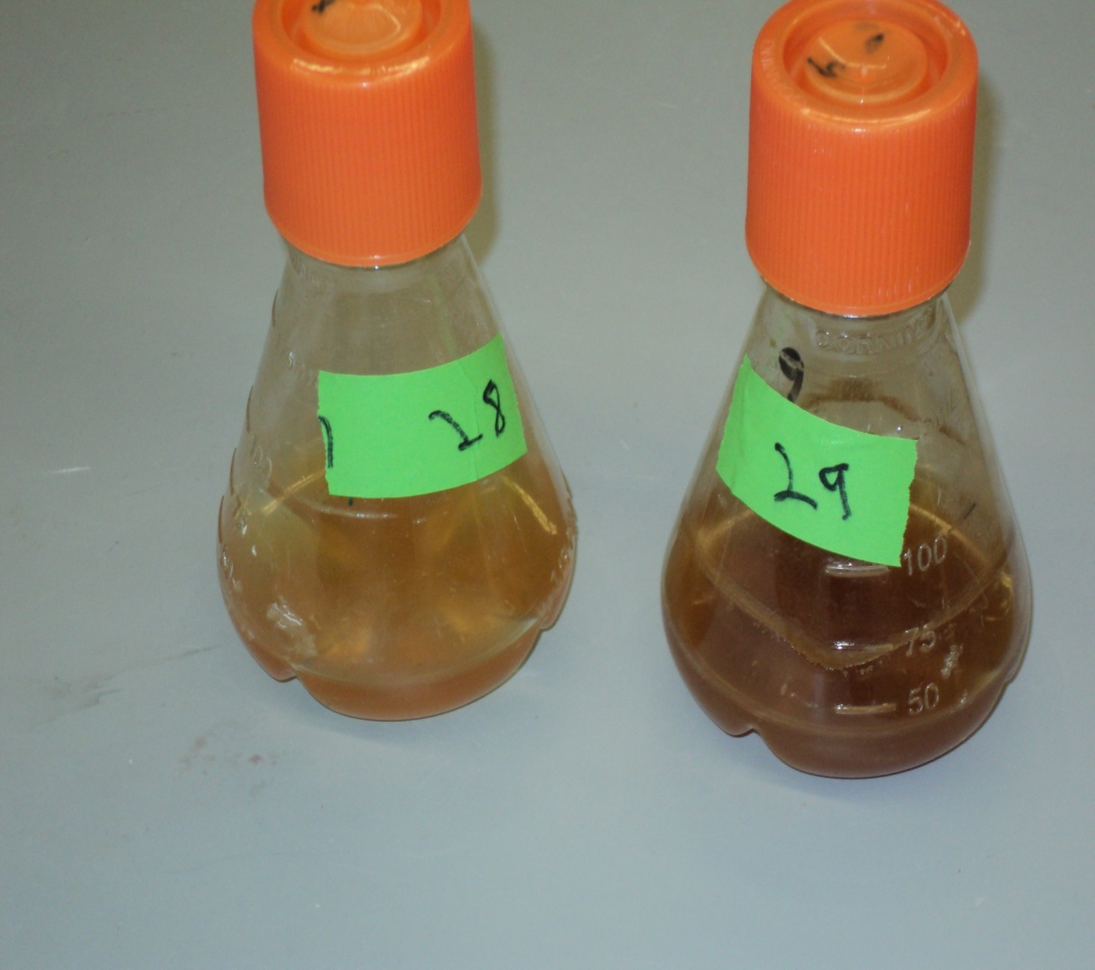

Slide 17
Ethanol Results
Manhattan Bagasse produced:
0.05 g ethanol/g biomass (0.02 – 0.08)
Garden City Bagasse produced:
0.08 g ethanol/g biomass (0.03 -0.16)
Corn Stover ethanol yield varied by population

Slide 18
Corn Population Effect
Plant Density | g ethanol/g biomass
138,000 | 0.039
105,500 | 0.045
85,300 | 0.047
47,400 | 0.045
2,900 | 0.042

Slide 19
Conclusions
A model is being developed to explain the relationship between sorghum population density and the total cellulosic ethanol/ha
Corn cellulosic ethanol/g appears to be steady. Further studies will be completed to look for significant differences.
Combining the biomass/ha and ethanol/g reveals the total ethanol/ha
Minimal changes in grain yield/ha over a 12,000 plant/ha domain for corn
  This allows for adjusting the seeding rate within this domain to maximize cellulosic ethanol production without effecting grain yield

